Slide 1

Intelligent Consumer Technologies
Incremental Face Recognition System
Anass nassiri
908475

Slide 2
Content
Introduction
Project Overview
Dataset Description
System Architecture
Incremental Learning Process
Data Preprocessing Pipeline
Model Architecture
Results
Hardware and environment
Practical testing
Conclusion and Future Work
References

Slide 3
Project Overview
The objective of the project is to make an Incremental Face Recognition System.
The scenario I work on is :
the system will authorized student to enter the exam classroom or not ,
if not and for example the professor want to add them, he can by capturing their picture and entering the name of student

Slide 4
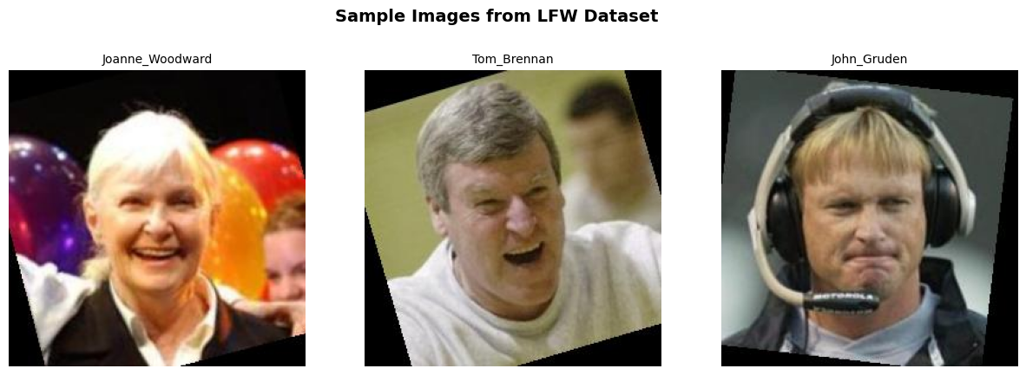
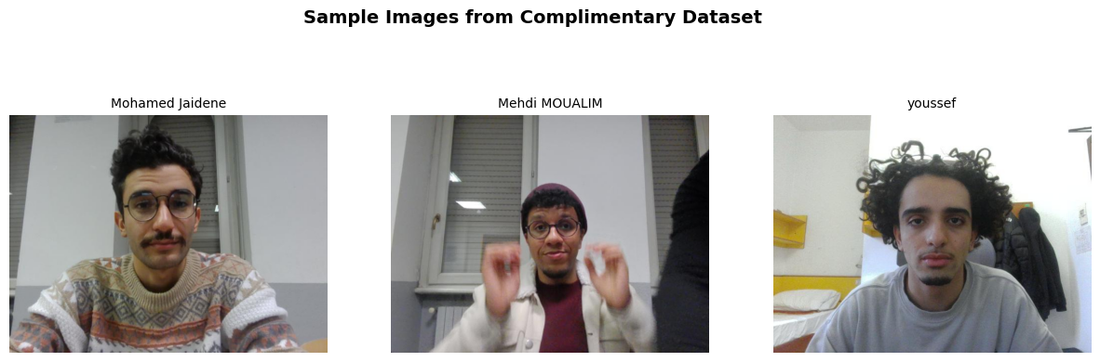
Dataset Description
LFW Dataset (Labeled Faces in the Wild)
13,000+ images, 5,749 individuals
Unconstrained real-world conditions (varied lighting, angles)
Used widely for face recognition & verification
Complementary Student Dataset
I collected images of some friend and colleges of mine
Collected images in a clear setting
Captured using the same webcam setup
Supports incremental learning by adding new users dynamically

Slide 5

Data Preprocessing Pipeline
Raw Input Image
Face Detection (MTCNN)
Face Cropping & Alignment
Resizing (160x160)
Data Augmentation
Normalization [-1,1]
Tensor Conversion
Face Embedding (512-D)

Slide 6
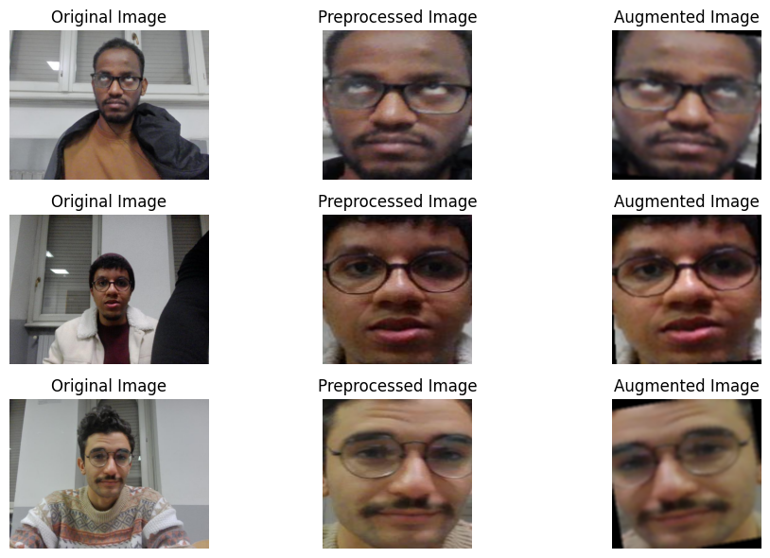
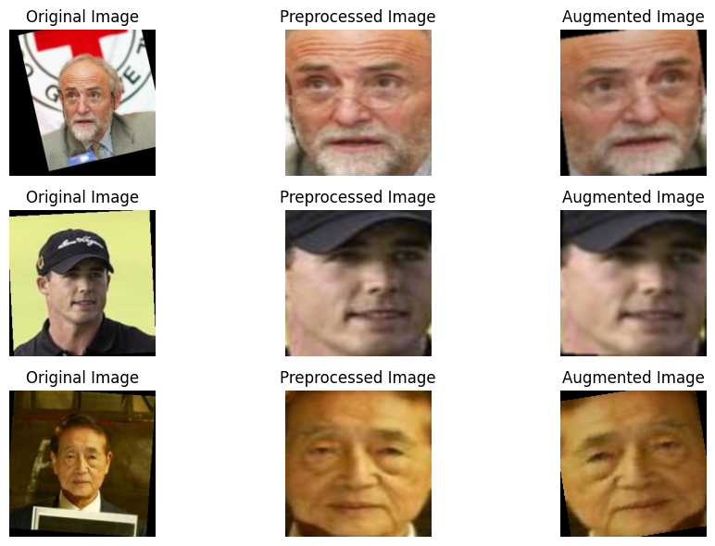
Images before and after preprocessing

Slide 7
Model Architecture
Input Image (160x160)
Conv Layers (FaceNet)
512-D Feature Embeddings"
Classifier (FC Layers)
Output: Identity Prediction

Slide 8
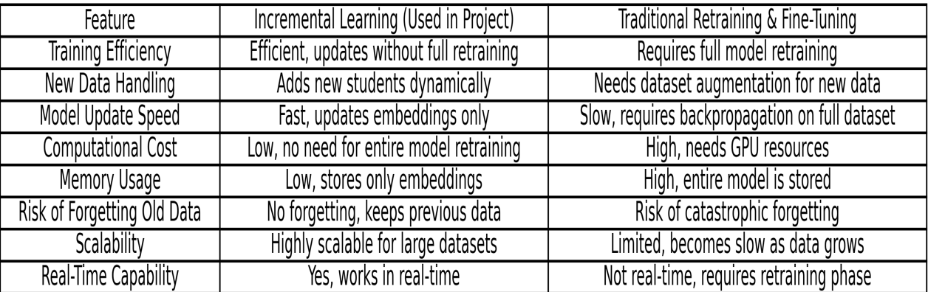
Models Comparison
The Incremental Learning approach I used in this project falls under "Feature-Based Incremental Learning" (also called Embedding-Based Incremental Learning).
This method does not retrain the full model but instead stores new embeddings for newly added students and updates the classifier dynamically.

Slide 9
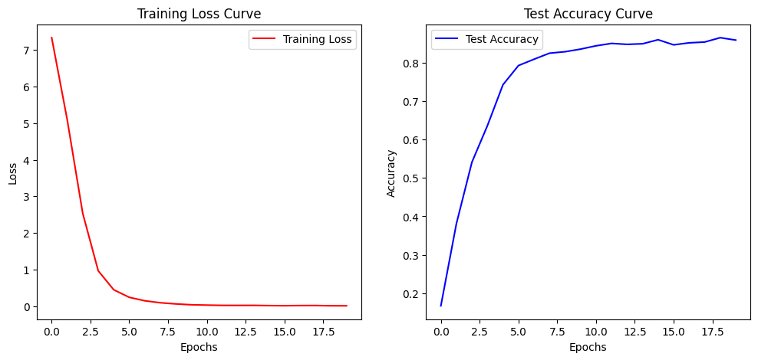

Slide 10
System Architecture - Incremental Face Recognition
Web App (Flask)
Face Detection (MTCNN)
Preprocessing Pipeline
Face Embedding (FaceNet)
Classifier Incremental Learning
Decision: Recognized/Not Recognized

Slide 11
How the Incremental learning work
Incremental Learning Process in Face Recognition
Face Detection (MTCNN): Detects and aligns faces from input images. Feature Extraction (FaceNet): Converts detected faces into 512-dimensional embeddings. Database Update: New embeddings are added to the existing database without retraining the entire model. Recognition (Euclidean Distance): Compares embeddings with stored ones to classify faces. Classifier Expansion: The classification layer updates dynamically to accommodate new students.

Slide 12
Diagram Workflow:
Start(capture Image)
Face Detection (MTCNN)
Preprocessing
Feature Extraction (FaceNet)
Compare With Stored Embeddings
Store Embedding & Update Classifier
Recognized (Grant Access)
Net Reconized(Enroll New Face)

Slide 13

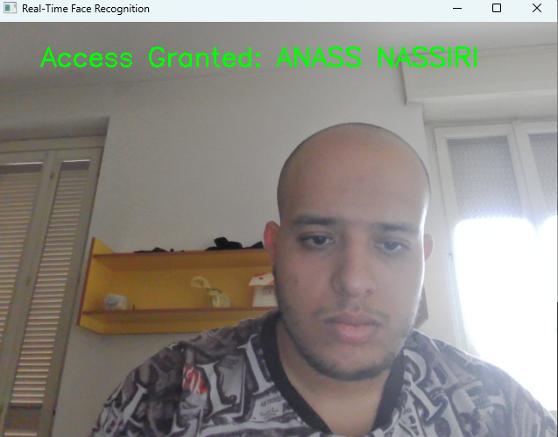
Results
This fegures before and after i add my self using the incrimental learnig system

Slide 14

Results
Here the system doesn’t recognize me, because i did’t train it on my face , I want to test the system by my face .
I deploy it in web applicationig using FLASK framwork

Slide 15
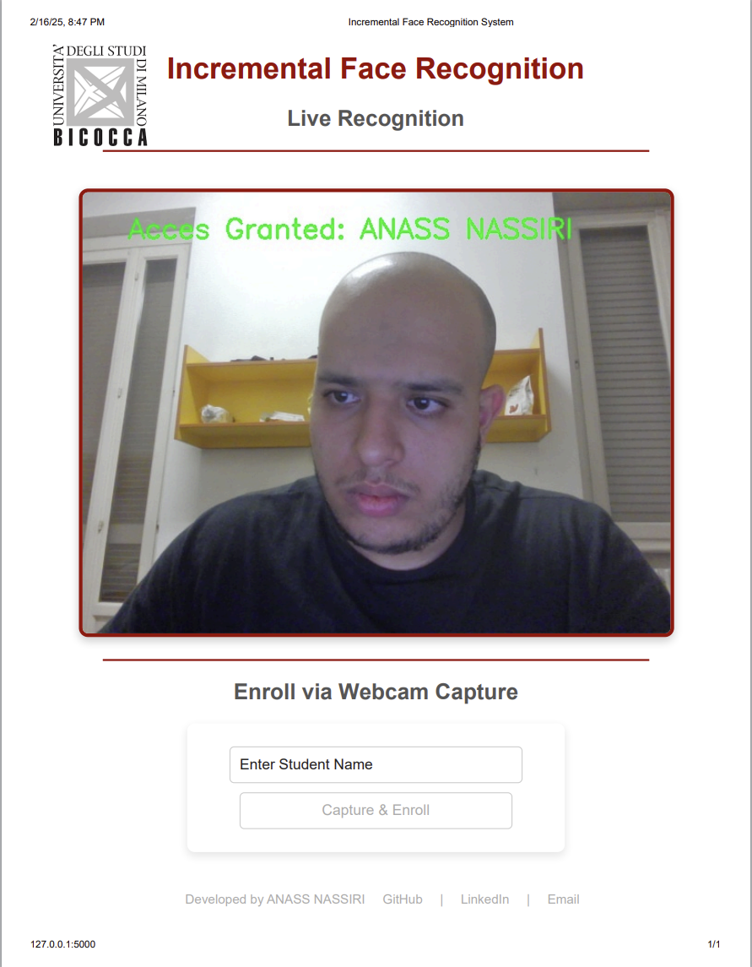
Here after I added my self by capturing my picture and entring my name, imidiatly the incrimental algorithm work and start reconizing my face

Slide 16

Hardware and environment
The hardware I used for computation for the entire project is :
i714700hq CPU
GPU NVDIA RTX 4070, Cuda API
RAM 32 GB
For capturing the Images:
Laptop webcam fullHD
The Environment used:
VS CODE collab notebook style
Pytorch,

Slide 17
Practical testing

Slide 18
Conclusion
Incremental face recognition provides an efficient, real-time approach to student authorization
The system enables dynamic learning without the need for full model retraining.
Accurate and scalable, ensuring long-term usability in real-world applications.

Slide 19
Future work
Deploy the system on edge devices or embedded hardware (Jetson Nano, Raspberry Pi).
Extend functionality to multi-camera networks and cloud-based authentication.
Optimize storage and retrieval of face embeddings for large-scale deployments.

Slide 20
References
LFW Dataset - Labeled Faces in the Wild for face recognition benchmarking.https://www.kaggle.com/datasets/jessicali9530/lfw-dataset/data
Incremental Learning - Continual learning approaches in classification.
https://doi.org/10.1016/j.neunet.2019.01.002
FaceNet - Deep learning-based face recognition and clustering.
https://arxiv.org/abs/1503.03832
MTCNN - Multi-task cascaded CNN for face detection & alignment.
https://arxiv.org/abs/1604.02878
Incremental Classifier Learning - Updating classifiers without full retraining.
https://arxiv.org/abs/2107.04464

